Slide 1




Review and rating project
Internship presentation
UNDER SUPERVISION OF :
Khushboo Garg
Presented By :
Miloni Shah

Slide 2
TABLE OF CONTENTS
INTRODUCTION
Data collection
Analytical Problem Framing
Data Pre-processing Done
Data Visualization
Model Evaluation
Conclusion

Slide 3
Introduction
The problem which I have faced while doing this project is that to scrap the data from Amazone websites and to scrap the laptops reviews and Ratings as well with huge no of 38400 rows data .am face many time only one problem that is finding the Rating .

Slide 4
Data collection
Firstly I have done the data extraction, for extracting I have used the amazon websites through that I have scraped the Rating and Reviews.
And I got 38400 rows for Laptops

Slide 5
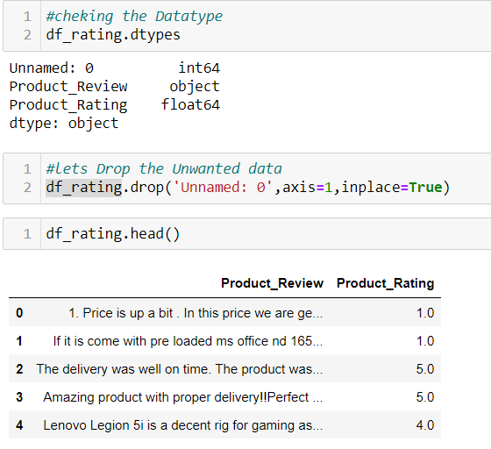
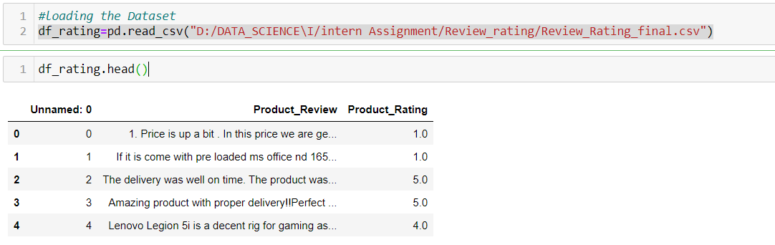
Analytical Problem Framing

Slide 6
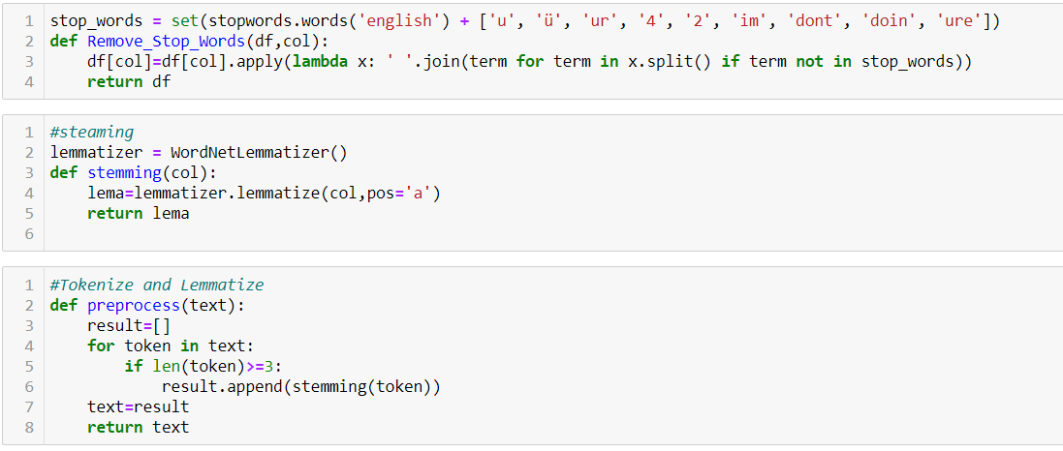
Data Pre-processing

Slide 7
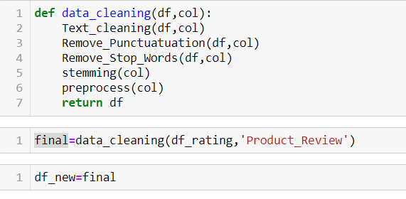
Data Pre-processing
Finally we are calling all the Data Pre-processing function on a single column
Now We have your cleaned Data

Slide 8
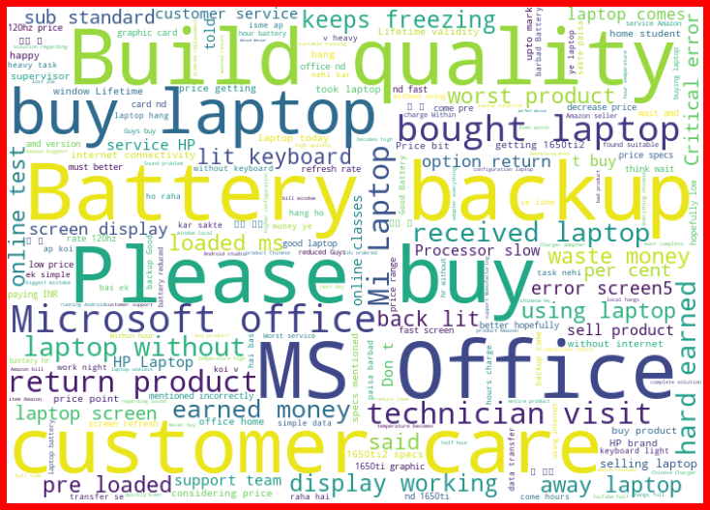
Analysis
We can see here which words are heavy when its comes to releted to rating “1”.

Slide 9
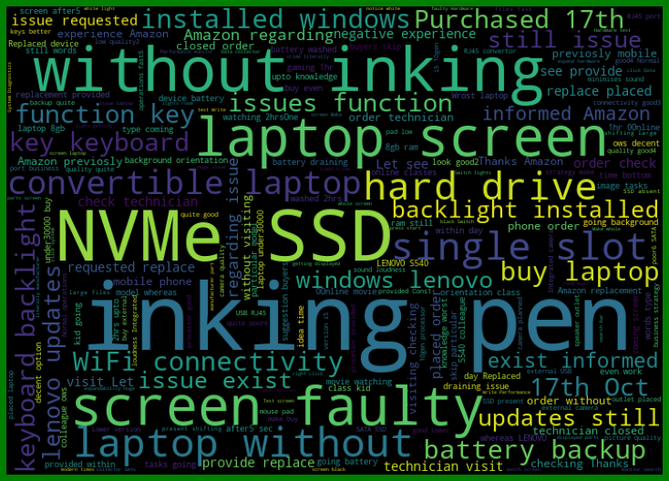
Analysis
We can see here which words are heavy when its comes to releted to rating “2”.

Slide 10
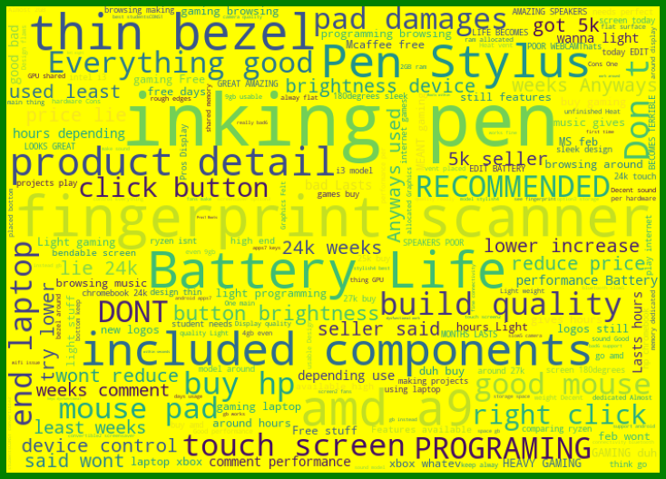
Analysis
We can see here which words are heavy when its comes to releted to rating “3”.

Slide 11
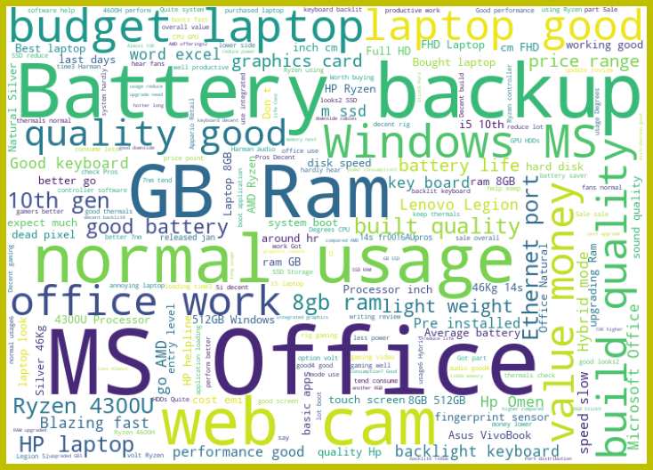
Analysis
We can see here which words are heavy when its comes to releted to rating “4”.

Slide 12
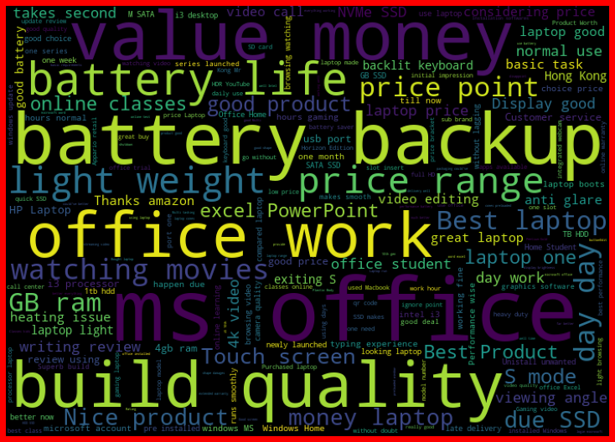
Analysis
We can see here which words are heavy when its comes to releted to rating “5”.

Slide 13
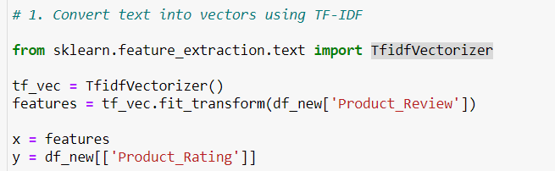
Feature Extraction
TFIDF vectorizer.

Slide 14
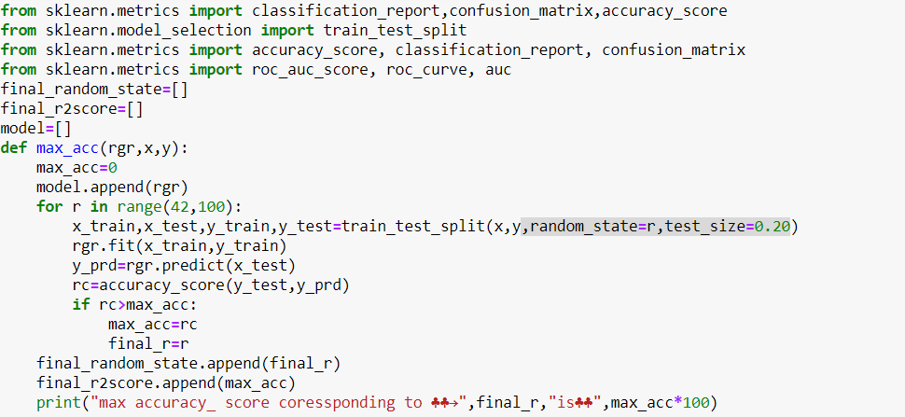
Model creation
Here We are making a function for model Training.

Slide 15
Used algorithms
Here we used below mention algorithms
1.Logisticregression
2. MultinomialNB
3. DecisionTreeClassifier
4. PassiveAggressiveClassifier
5. RandomForestClassifier

Slide 16
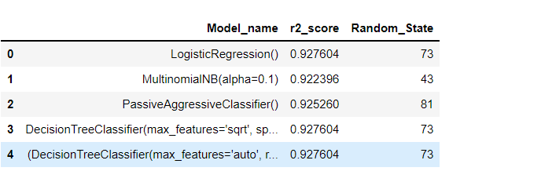
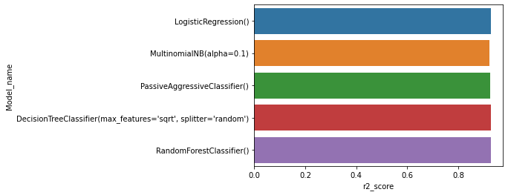
Model Selection
After trained our data in different model we got the result

Slide 17
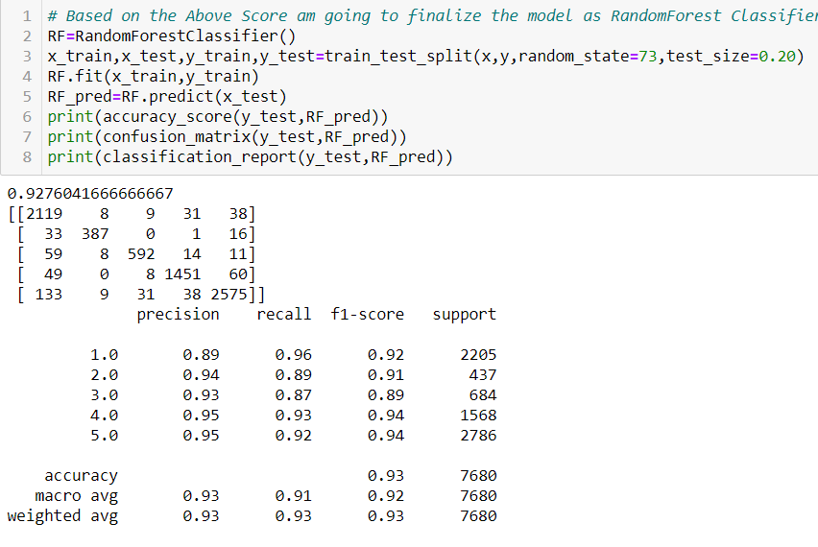
Model finalize
We got the result where Randomforest is working good so am finalize Randomforestclassifier as my final model.

Slide 18
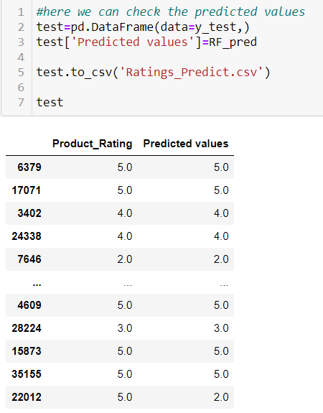
Actual vs Predict

Slide 19
CONCLUSION
Key Findings and Conclusions of the Study
The key findings that I have find that I have scraped it from only one websites due to dead line I was able to scrap it .if I could scrap more websites we will get more better model prediction.
By using 38400 data we for two best models Random Forest Classifier and Decision Tree Classifier. Because of limited data I haven’t go for sampling only just used stratify method to balance the data.
Limitations of this work and Scope for Future Work.
In some algorithms where was taking to much time to execute but it was executed it in better way. because of that laptops where getting hang and as we accept we got better score in every model.

Slide 20

Question

Slide 21


